Slide 1
<ARVRVE-Senior Project>
Team Members: <Carlos Martinez, Mairim Barrios, Arelys Alvarez, Fidel Hernandez, Samira Tellez> Product Owner: Francisco Ortega
Instructor: Francisco Ortega School of Computing and Information Sciences Florida International University
Final Presentation
<Sprint 2018>
The logo of your project
Notes:
7 seconds.( I will select 2 best slides (i will give them extra points and students will present for CIS committee)
Greet your audience, thank them for attending your presentation, introduce yourself, introduce your project, introduce your team members, and quickly indicate what each of you did in a high-level manner, and put more emphasis on your part/contribution.

Slide 2

Project definition
Screenshots or GIF pictures of the whole project
Notes:
10 seconds.
Introduce the problem that the whole project (in all versions) tackles with GIF or screenshot.

Slide 3
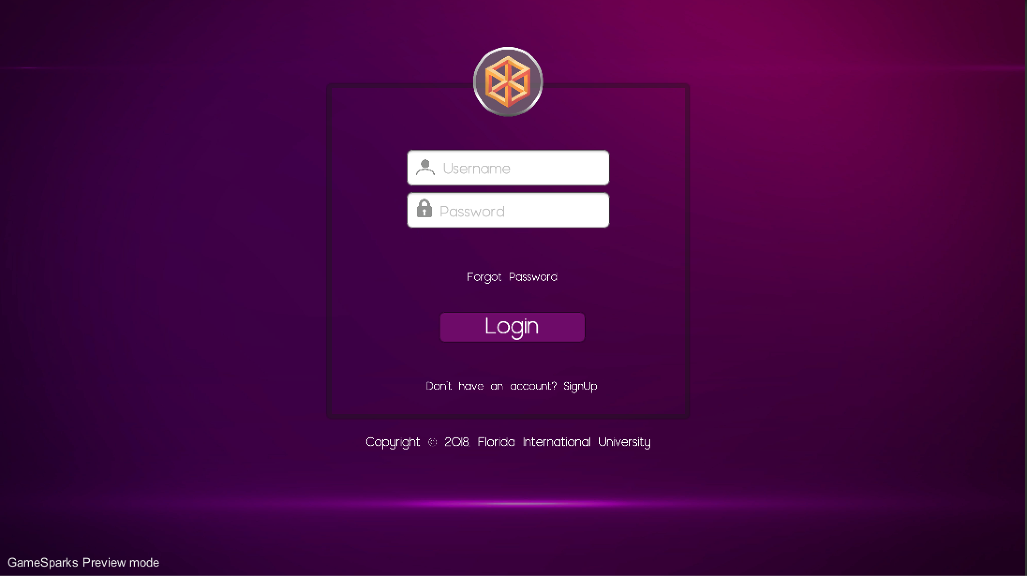
Project definition
Screenshots or GIF pictures of the new version
Notes:
20 seconds.
Introduce the problem that the your project (in new version) tackles with GIF or screenshot.

Slide 4
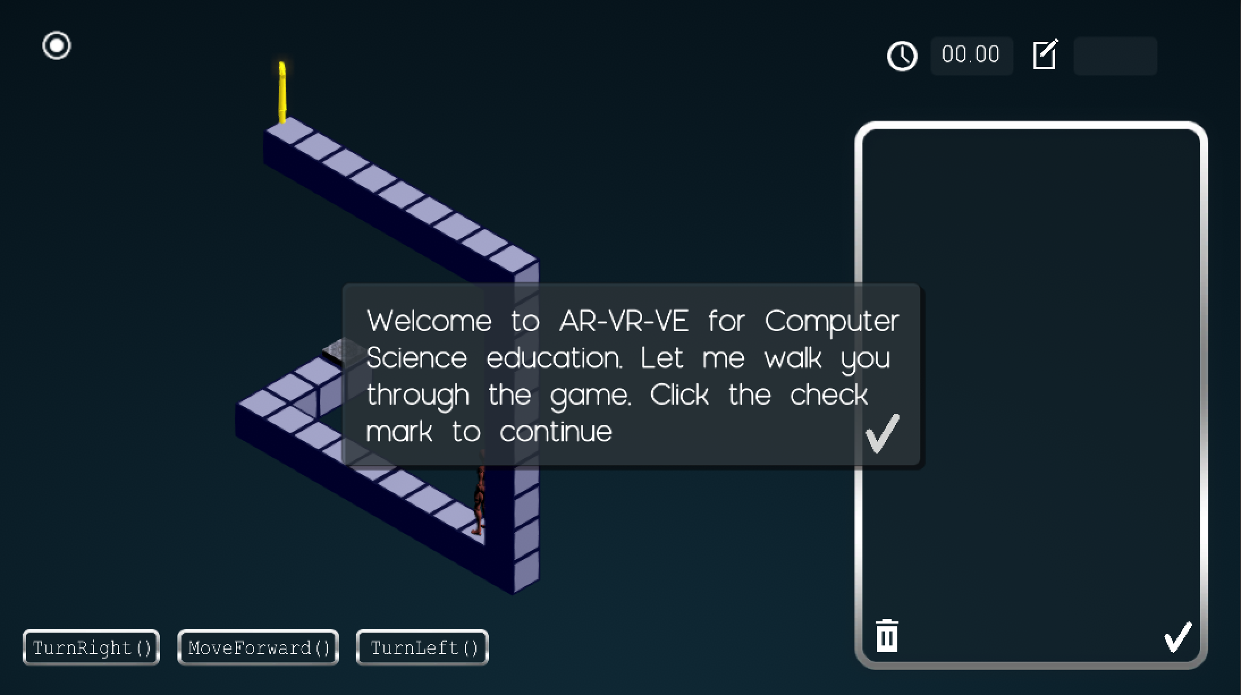
Project definition
Screenshots or GIF pictures of the new version
Notes:
20 seconds.
Introduce the problem that the your project (in new version) tackles with GIF or screenshot.

Slide 5
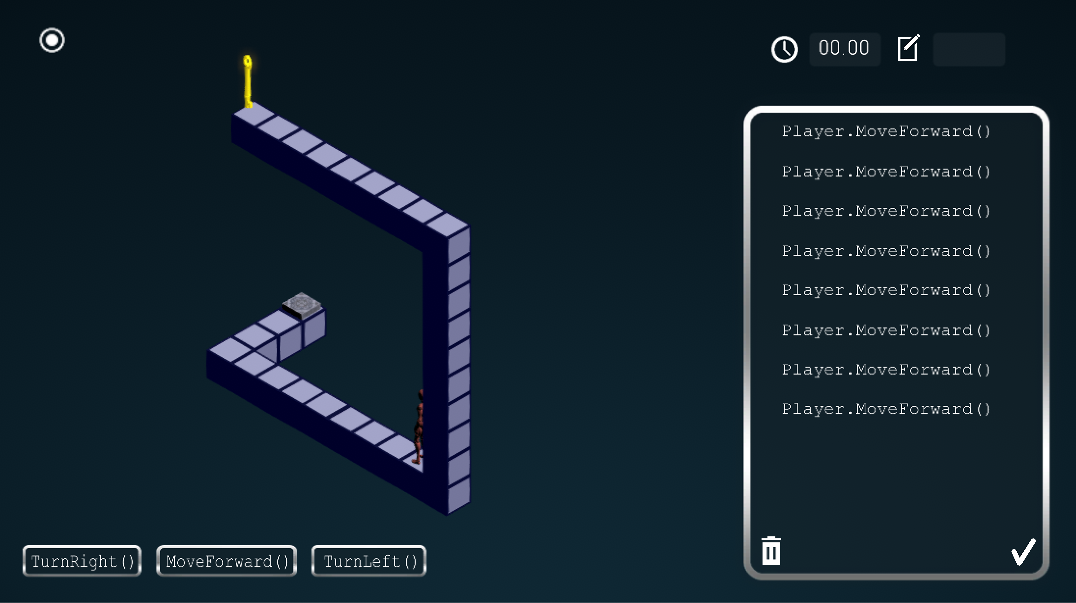
Project definition
Screenshots or GIF pictures of the new version
Notes:
20 seconds.
Introduce the problem that the your project (in new version) tackles with GIF or screenshot.

Slide 6
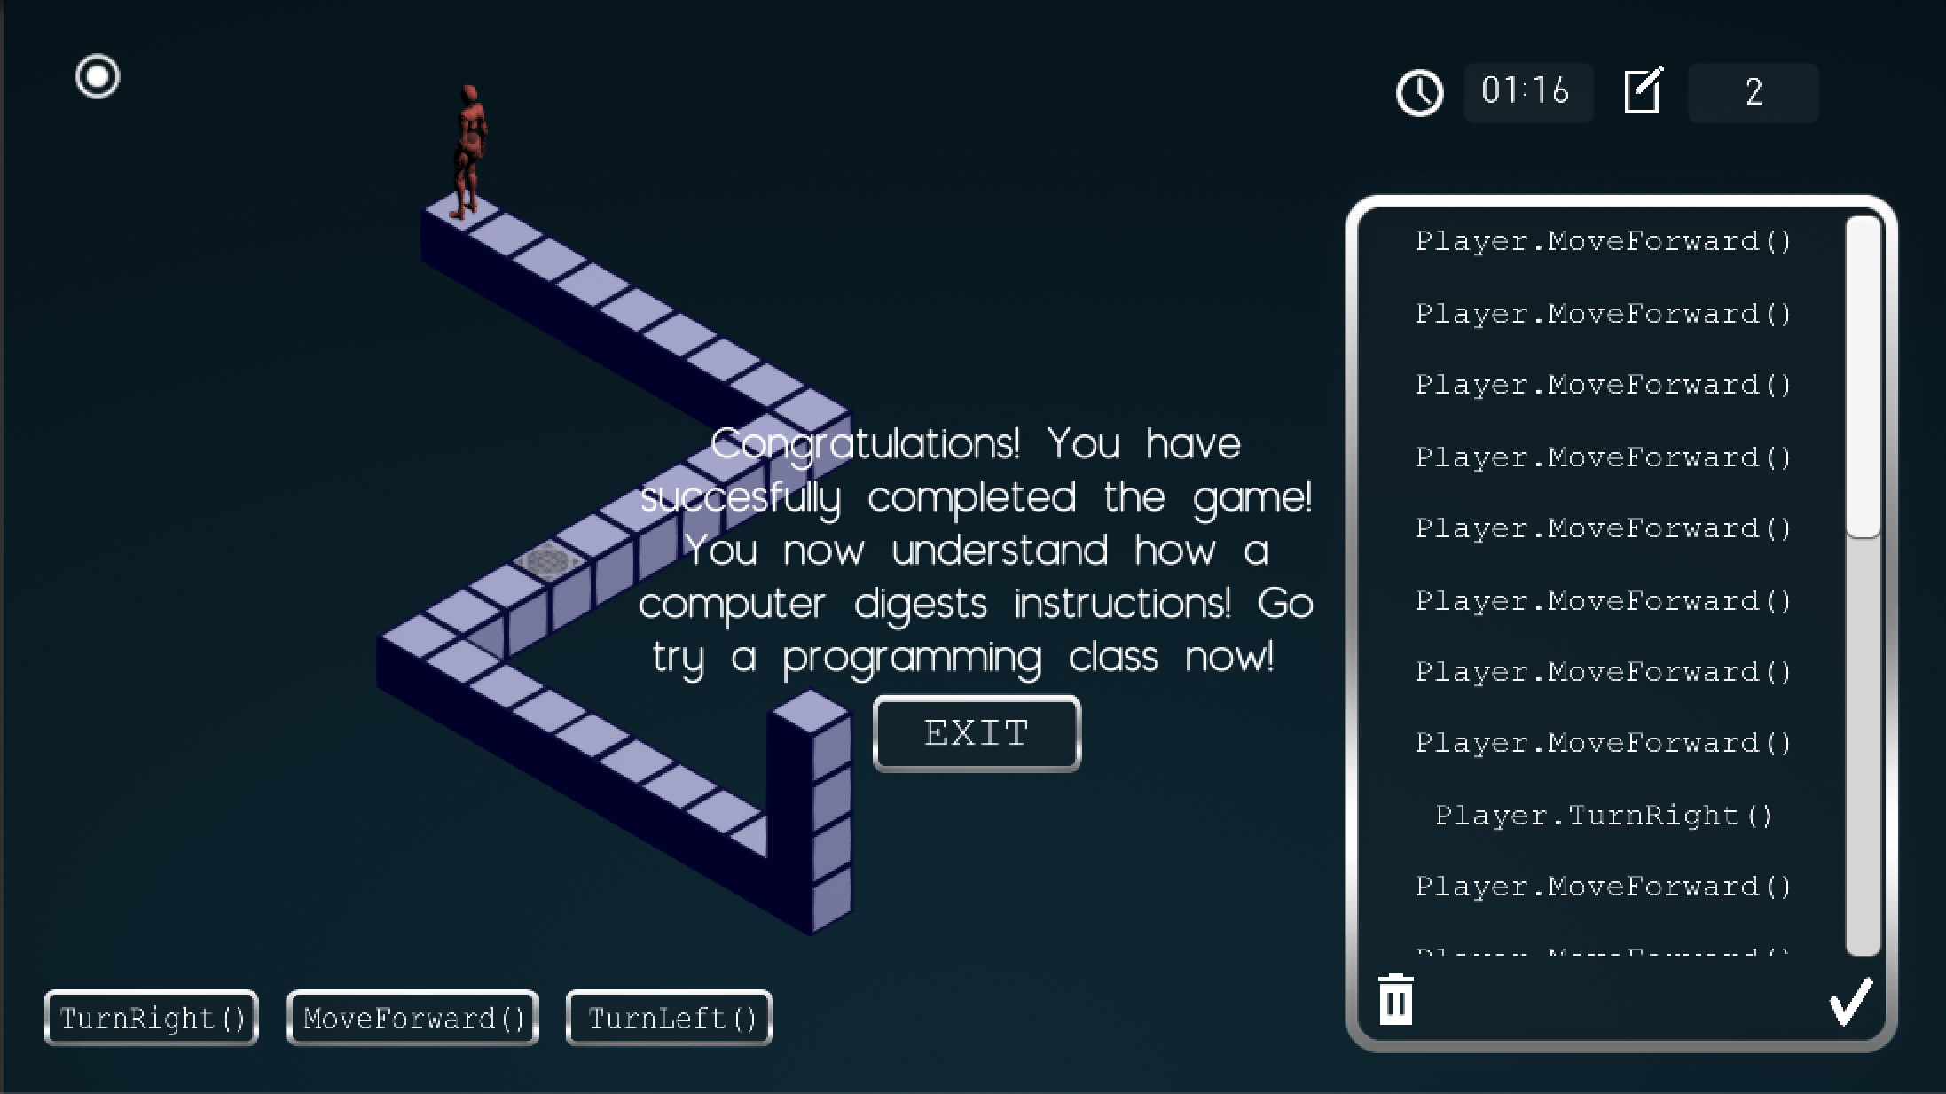
Project definition
Screenshots or GIF pictures of the new version
Notes:
20 seconds.
Introduce the problem that the your project (in new version) tackles with GIF or screenshot.

Slide 7
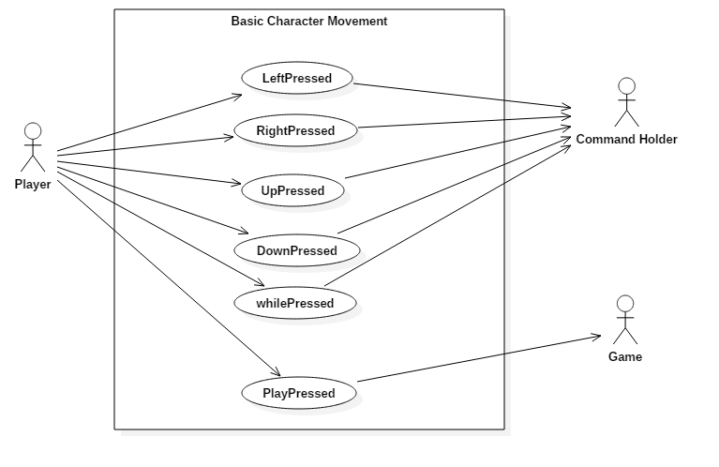
Requirements: Use Cases
Notes:
5 seconds
Show the Use Case Diagram for the whole project. Highlight your use cases.

Slide 8
System Design: Architecture
The system was structured in a MVC architecture. Where the Models are the game objects such as the player, the maze, the solution panel and the controls. The Unity scene that shows the user interface was treated as the View, and lastly, the C# scripts that allowed for communication between the Unity Scene and the backend, was treated as the Controller. This structure separates the business layer, the user interface and the database logic from each other.
Notes:
20 seconds
System design: Highlight the parts that you contributed to them.
1. System decomposition; identify the architecture patterns used
2. System deployment – h/w and s/w requirements

Slide 9
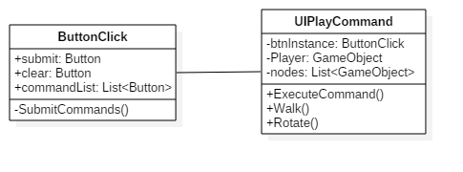
Minimal Class Diagram
Notes:
10 seconds.Minimal class diagram. Highlight the classes that you created/modified
Identify the design patterns used (one or more slides).

Slide 10
User Stories
1.As a user I would like there to be a way for I can put my commands in a loop so that I can use less commands to reach the end of the level
2.As a user I would like to move my character in the basic cardinal directions so that I could properly play the game.
3.As a user I would like to be able to issue multiple while loop commands so if I need to use more than one while loop to solve a problem I can do so with ease.
4.As a developer I would like to have it so that the character when moving around does so smoothly so that the user never notices any jerky movement.
5.As a user I would like there to be a pause menu so that I can take a break from the game whenever I desire.
Notes:
5 seconds.
List the user stories that you worked on them.(put in order of importance). Stay focused on the parts that you have been working.

Slide 11
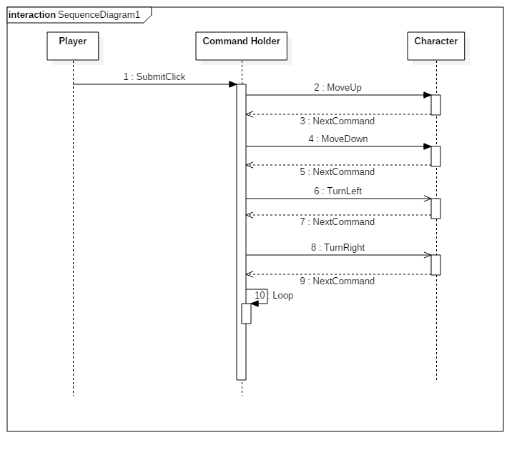
Loop Command
Notes:
60 seconds
The tile of user story
The most important user story you worked on it. You have to describe this one very well and be proud of that.
Please present and show the complexity of your work, code, algorithms, and technical challenges and technologies you have used. (you could use screenshot if you want. Visual presentations are better than text presentation)
Go into the details of the most important/significant tasks using bullet lists or visual graphs or state chart diagram
Sequence Diagram for this user story is mandatory (in another separate page if required)
Demo using screenshots or GIF (in another separate page if required)

Slide 12
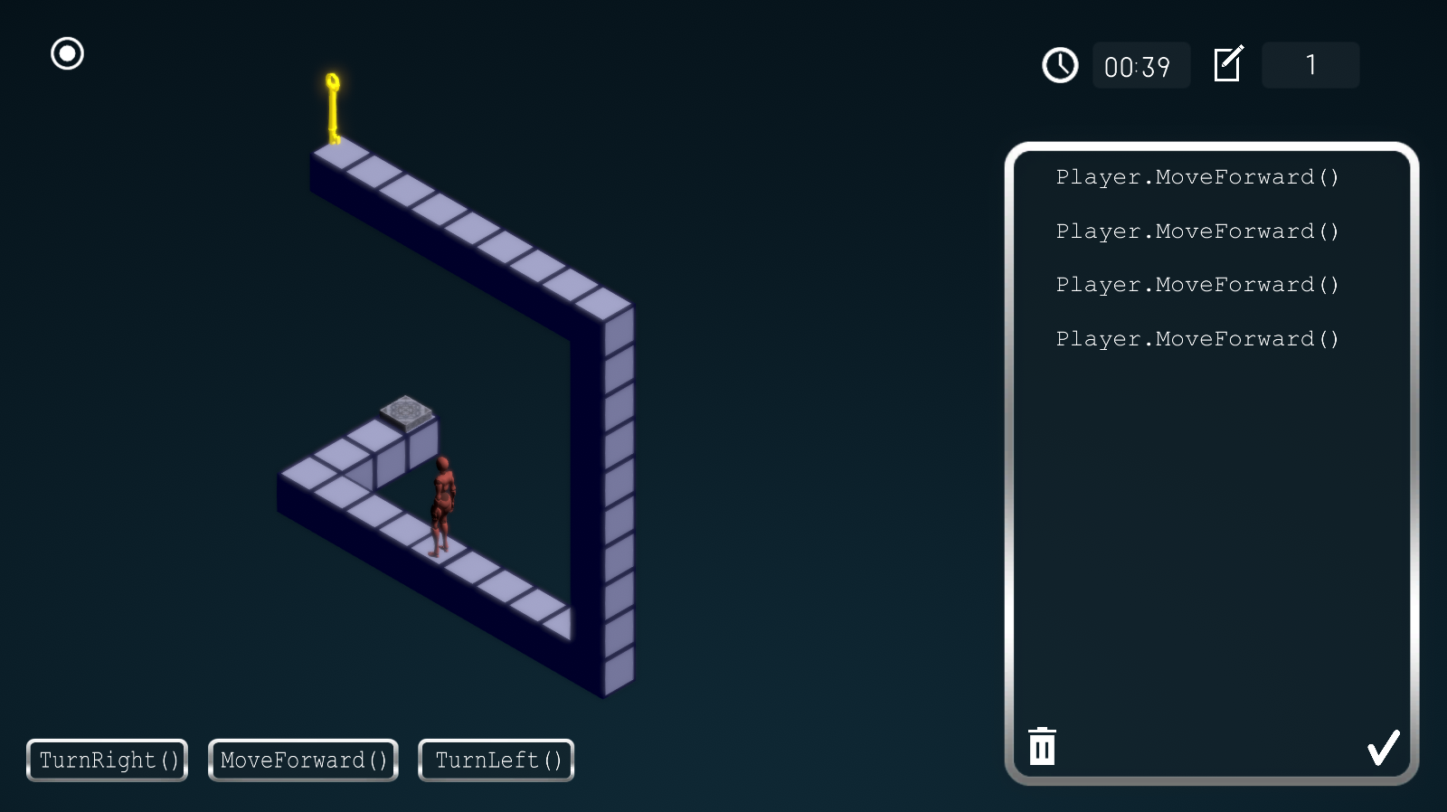

Test Suites and Test Cases
Sunny Day Test
User presses four “Move Forward” Commands Purpose: To see if character won't walk past the wall
Notes:
10 seconds
A description of verification process and Test Suites and Test Cases for one of the use cases.
1 One sunny day and one rainy day for the implemented use cases (one or more slides).
2 Automated test scripts for the implemented use cases (if any) (one or more slides).

Slide 13
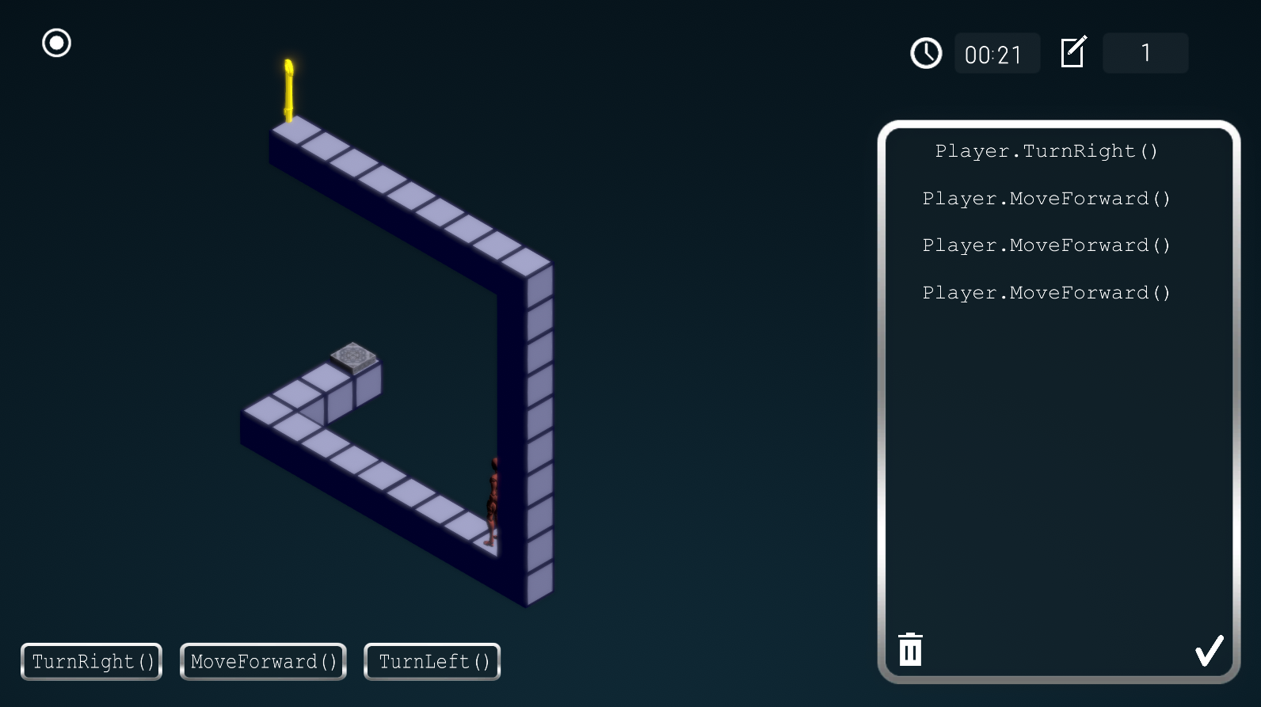

Test Suites and Test Cases
Rainy Day Test
User turns right then attempts to walk forward three times
Purpose: To see if character won't walk past the wall

Slide 14




Summary
Carlos Martinez
cmart352@fiu.edu
Notes:
10 seconds
Summarize your contribution, mention your effort for Scrum, Mingle, Github, Google Drive Documentation and minutes
Include your contact information
Ask if anyone has any questions for you.
Thank your audience

